Slide 1
Digitization and Modernization of Estonian Railways 2019 - 2028
Infrastructure modernization projects
and the gradual transition to modern technologies
Märt Ehrenpreis
V.0201-20F

Slide 2
Agenda
Basic network and maintenance information
Modernization of the Control Command and Signalling system
Railway electrification
Summary of major projects

Slide 3
Basic network and maintenance information
Points: 1195 pcs
Signals: 2080 pcs
Automatic block lines: 480 km
Level crossings: 152 pcs
Hot-Boxes: 29 pcs
Network: 1219 km
Mainlines: 795 km
Electrified track: 130 km
Platforms: 129 pcs
Stations: 61 pcs
Maximum speed: 120 km/h
Employees ca: 700
ISO 9001:2018
ISO 14001:2018

Slide 4
Modernization of the Control Command and Signalling system
2019 - 2027

Slide 5
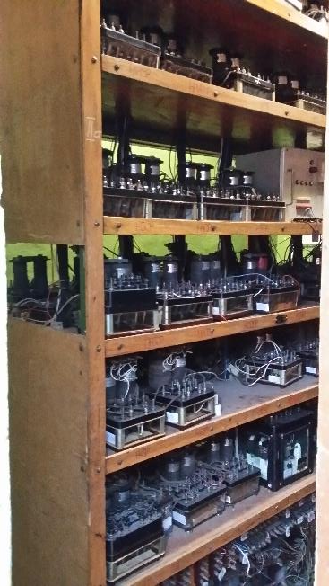
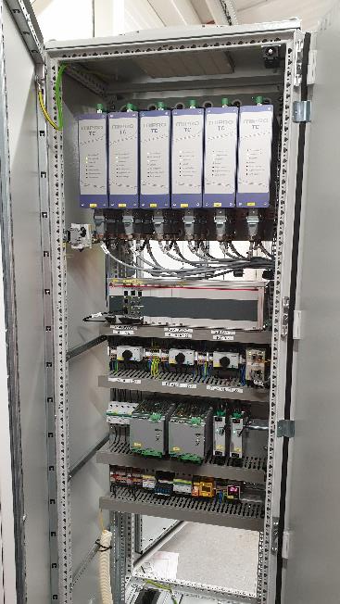
Current status of the modernization of CCS
Modernization in progress or ready
%
Need to modernize

Slide 6
Modernization of railway safety equipment and peripheral systems 2019 - 2027
Stage 0 (2019 - 2020)
Preparation of technical concept and project documentation
Stage 1 (2020 - 2024)
Modernization of signalling system and creation of conditions for the deployment of ERTMS
FOUNDATION
Stage 2 (2021 - 2024)
Modernization of signalling system and creation of conditions for the deployment of ERTMS
Stage 3 (2025 - 2027)
Deployment of ERTMS (ETCS L1 FS / LS)

Slide 7
Stages of modernization
Line 1
Stage1 (2020 - 2024) Line 2, 3, 4, 6
Stage 2 (2021 - 2024) Line 1, 5
Stage 3 (2025 - 2027) Gradual introduction of ETCS systems throughout the railway network
Line 2
Line 7
Line 3
Line 6
Eesti Raudtee
Edelaraudtee
Rail Baltica
Helsinki–Tallinn tunnel
Line 4
Line 5

Slide 8
Concept of modernization of signalling system
The modernization is to be carried out as separate sub-projects to allow the CCS suppliers to focus on their core competencies (e.g. the construction of equipment facilities is procured separately and is not the responsibility of the system suppliers)
Modernization work will start parallelly on different sections of the track
Open information session for system vendors
Project related news on our company´s website https://www.evr.ee/et/ettevottest#uudised
Information on the project concept and a list of individual projects can be found in the National Procurement Register https://riigihanked.riik.ee/rhr-web/#/

Slide 9
Railway electrification
2020 - 2028

Slide 10
Further electrification of the rail network 2020 - 2028
Järve
Raasiku
Püssi
Oru
Keila
Tapa
Line voltage: 25 kV AC (West from Tallinn 3 kV DC)
Power supply for substations: 110 kV network
Design speed of the electrified line: 160 km/h
Stations: 47 pcs
Riisipere
3 kV DC substation
25 kV AC substation
Jõgeva
3 kV DC electrified track
25 kV AC electrified track
non electrified track
Tartu
Põlva
Sangaste

Slide 11
Major projects in the modernization period 2019 - 2028
Signalling system modernization
Railway electrification
Automation of traffic control and scheduling
Telecommunication networks EN 50159 conformity assessment and modernization
GIS track-based asset management system
Automation of maintenance process tracking and fault statistics based training system

Slide 12
Notes:
Kokkuvõte

Slide 13
Thank you!
evr.ee

